Slide 1
B Tree

Slide 2
Introduction to B-Tree
B-trees are balanced search tree.
More than two children are possible.
B-Tree, stores all information in the leaves and stores only keys and Child pointer.
If an internal B-tree node x contains n[x] keys then x has n[x]+1 children.

Slide 3
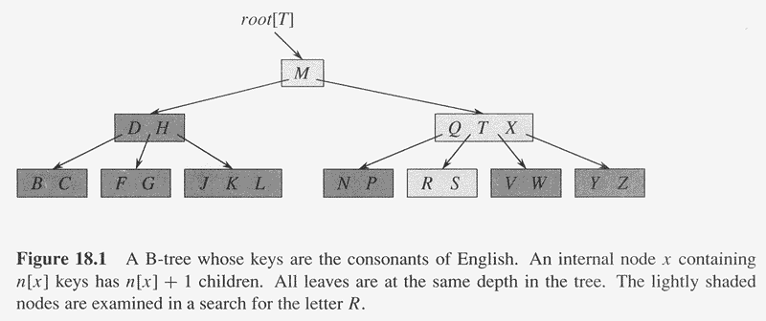
Example of B-Tree

Slide 4
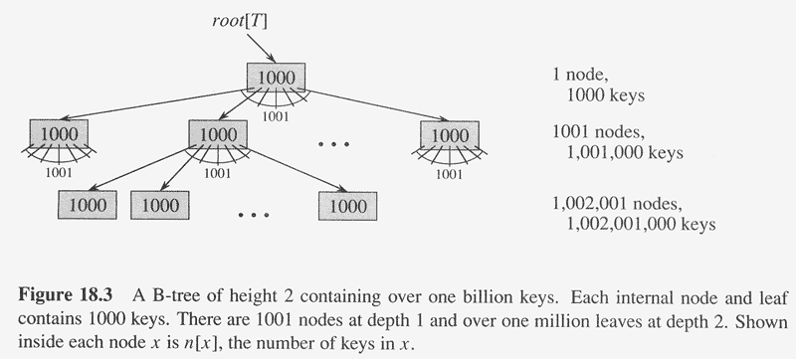
Another example of B-Tree

Slide 5
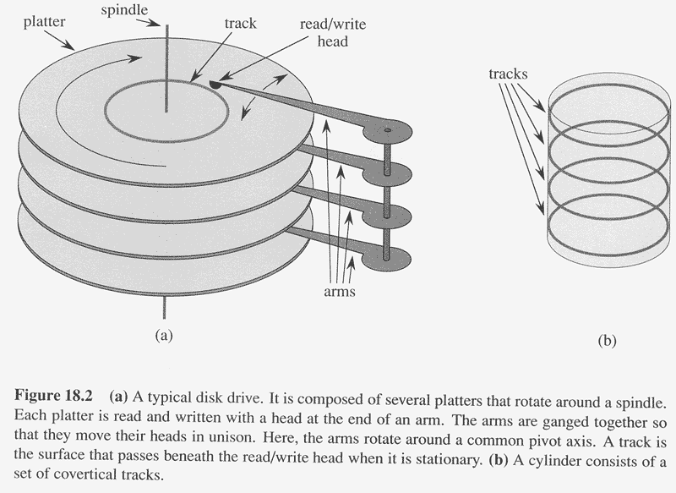
Application of B-Tree
It designed to work on magnetic disks or other (direct access) secondary storage devices.

Slide 6
Properties of B-Tree
A B-Tree T is a rooted tree having the following properties:
  Every node x has the following fields:
    n[x] the no. of keys currently stored in node x
    The n[x] keys themselves, stored in non-decreasing order, so that key₁[x] ≤ key₂[x]…… ≤key_{n-1}[x] ≤ key_{n}[x].
    Leaf[x], a Boolean value that is TRUE if x is a leaf and FALSE if x is an internal node.
  Each internal node x also contains n[x]+1 pointers (Childs) c₁[x], c₂[x],---------c_{n[x]+1}[x].
  All leaves have the same depth, which is the tree’s height h.

Slide 7
Properties of B-Tree (cont.)
4. There are lower and upper bounds on the no. of keys a node can contains: these bounds can be expressed in terms of a fixed integer t≥2 called the minimum degree of B-Tree.
  Every node other than the root must have at least t-1 keys, then root has at least t children if the tree is non empty the root must have at least one key.
  Every node can contain at most 2t-1 keys. Therefore, an internal node can have at most 2t children we say that a node is full if it contains exactly 2t-1 keys.

Slide 8
Height of B-tree
• Theorem:
If n ≥ 1, then for any n-key B-tree T of height h and minimum degree t ≥ 2,
h ≤ log_{t} (n+1)/2
• Proof:
– The root contains at least one key
– All other nodes contain at least t-1 keys.
– There are at least 2 nodes at depth 1, at least 2t nodes at depth 2, at least 2t^{i-1} nodes at depth i and 2t^{h-1} nodes at depth h

Slide 9
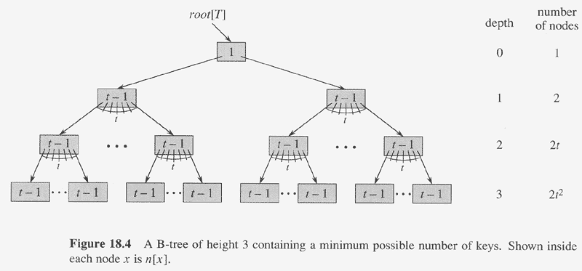
Copyright © The McGraw-Hill Companies, Inc. Permission required for reproduction or display.

Slide 10
Basic operation on B-tree
B-TREE-SEARCH :-Searching in B Tree
B-TREE-INSERT :-Inserting key in B Tree
B-TREE-CREATE :-Creating a B Tree
B-TREE-DELETE :- Deleting a key from B
Tree

Slide 11
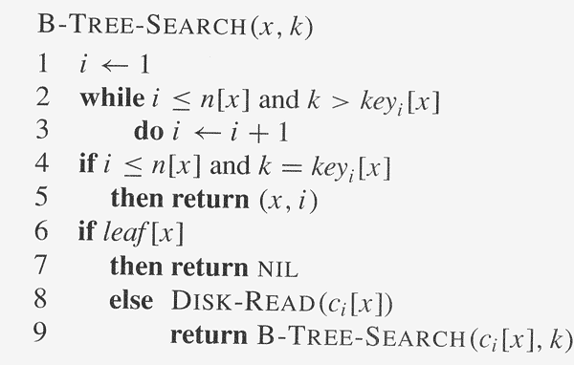
X is a subtree and k is searching element
Complexity=O(t)
Complexity= O(log_{t} n)

Slide 12
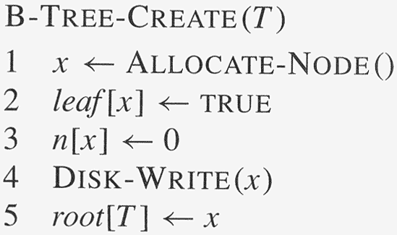
Creating an empty B tree

Slide 13
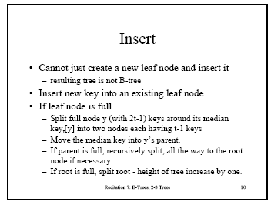

Slide 14
INSERT

Slide 15
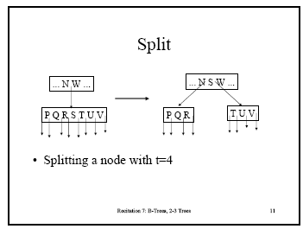

Slide 16
B-TREE-SPLIT-CHILD ALGORITHM
B-TREE-SPLIT-CHILD(x,i,y)
z← ALLOCATE-NODE()
leaf [z]← leaf [y]
n[z]←t-1
for j← 1 to t-1
do key_{j} [z] ← key_{j+t} [y]
if not leaf [y]
then for j←1 to t
do c_{j} [z]← c_{j+t} [y]
n[y]← t-1

Slide 17
cont…….
for j← n[x] +1 downto i+1
do c_{j+1} [x]← c_{j} [x]
c_{j+1} [x] ← z
for j← n[x] downto i
do key_{j+1} [x] ← key_{j} [x]
key_{i} [x] ← key_{t} [y]
n[x]←n[x] +1
DISK-WRITE(y)
DISK-WRITE(z)
DISK-WRITE(x)

Slide 18
B-TREE-INSERT ALGORITHM
B-TREE-INSERT(T,k)
1. r ← root[T]
2. If ( n[r] = 2t-1)
then s← Allocate-Node()
root[T] ← s
leaf[s] ← FALSE
n[s]←0
c₁[s]←r
B-TREE-SPLIT-CHILD(s,1,r)
B-TREE-INSERT-NONFULL(s,k)
else B-TREE-INSERT-NONFULL(r,k)

Slide 19
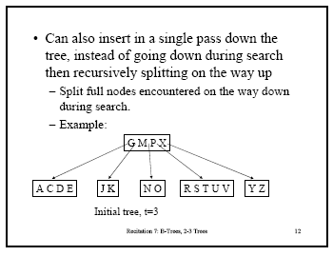

Slide 20
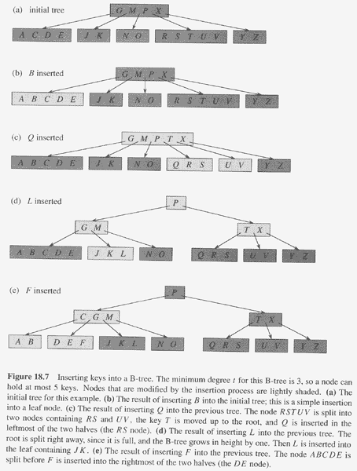
t=3

Slide 21
Insert Example
t = 3
G M P X
A C D E
J K
N O
R S T U V
Y Z
Insert B
G M P X
A B C D E
J K
N O
R S T U V
Y Z
Comp 750, Fall 2009
B-Trees - <number>

Slide 22
Insert Example (Continued)
G M P X
A B C D E
J K
N O
R S T U V
Y Z
Insert Q
G M P T X
A B C D E
J K
N O
Q R S
U V
Y Z
Comp 750, Fall 2009
B-Trees - <number>

Slide 23
Insert Example (Continued)
G M P T X
A B C D E
J K
N O
Q R S
U V
Y Z
Insert L
P
G M
T X
A B C D E
J K L
N O
Q R S
U V
Y Z
Comp 750, Fall 2009
B-Trees - <number>

Slide 24
Insert Example (Continued)
P
G M
T X
A B C D E
J K L
N O
Q R S
U V
Y Z
Insert F
P
C G M
T X
A B
D E F
J K L
N O
Q R S
U V
Y Z
Comp 750, Fall 2009
B-Trees - <number>

Slide 25
Constructing a B-tree
Suppose we start with an empty B-tree and keys arrive in the following order:1 12 8 2 25 6 14 28 17 7 52 16 48 68 3 26 29 53 55 45
We want to construct a B-tree of degree 3
The first four items go into the root:
To put the fifth item in the root would violate condition 5
Therefore, when 25 arrives, pick the middle key to make a new root
1
2
8
12

Slide 26
Constructing a B-tree
Add 6 to the tree
Exceeds Order. Promote middle and split.
1
2
8
12
25
1 12 8 2 25 6 14 28 17 7 52 16 48 68 3 26 29 53 55 45

Slide 27
Constructing a B-tree (contd.)
8
1
2
12
25
6, 14, 28 get added to the leaf nodes:
8
1 12 8 2 25 6 14 28 17 7 52 16 48 68 3 26 29 53 55 45
1
2
6
14
28
1
2
12
25

Slide 28
Constructing a B-tree (contd.)
Adding 17 to the right leaf node would over-fill it, so we take the middle key, promote it (to the root) and split the leaf
8
25
28
28
1
2
6
17
2
12
14
1 12 8 2 25 6 14 28 17 7 52 16 48 68 3 26 29 53 55 45
1 12 8 2 25 6 14 28 17 7 52 16 48 68 3 26 29 53 55 45

Slide 29
Constructing a B-tree (contd.)
7, 52, 16, 48 get added to the leaf nodes
8
17
7
25
28
48
1
2
6
12
14
52
1 12 8 2 25 6 14 28 17 7 52 16 48 68 3 26 29 53 55 45
16

Slide 30
Constructing a B-tree (contd.)
Adding 68 causes us to split the right most leaf, promoting 48 to the root
8
17
1 12 8 2 25 6 14 28 17 7 52 16 48 68 3 26 29 53 55 45
1
2
6
7
12
14
16
25
28
48
52
68

Slide 31
Constructing a B-tree (contd.)
Adding 3 causes us to split the left most leaf
8
17
48
7
2
6
7
12
14
16
1
3
25
28
52
68
1 12 8 2 25 6 14 28 17 7 52 16 48 68 3 26 29 53 55 45

Slide 32
Constructing a B-tree (contd.)
Add 26, 29, 53, 55 then go into the leaves
3
8
17
48
1
2
6
7
12
14
16
25
26
28
52
53
68
55
29
1 12 8 2 25 6 14 28 17 7 52 16 48 68 3 26 29 53 55 45

Slide 33
Constructing a B-tree (contd.)
Add 45 increases the trees level
Exceeds Order. Promote middle and split.
Exceeds Order. Promote middle and split.
3
8
17
48
1 12 8 2 25 6 14 28 17 7 52 16 48 68 3 26 29 53 55 45
1
2
6
7
12
14
16
25
26
28
29
45
52
53
55
68

Slide 34
Exercise in Inserting a B-Tree
Insert the following keys in B-tree when t=3 :
3, 7, 9, 23, 45, 1, 5, 14, 25, 24, 13, 11, 8, 19, 4, 31, 35, 56
Check your approach with a neighbour and discuss any differences.

Slide 35
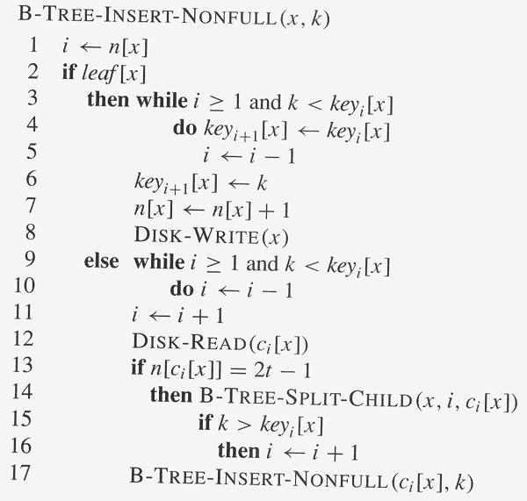
Copyright © The McGraw-Hill Companies, Inc. Permission required for reproduction or display.

Slide 36
Deleting from B-Trees

Slide 37
The Concept
You can delete a key entry from any node.
->Therefore, you must ensure that before/after deletion, the B-Tree maintains its properties.
When deleting, you have to ensure that a node doesn’t get too small (minimum node size is T – 1). We prevent this by combining nodes together.

Slide 38
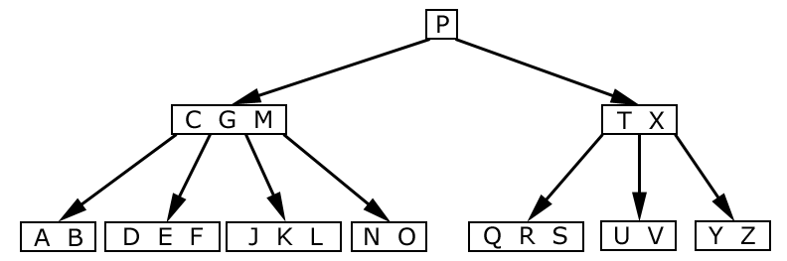
Lets look at an example:
We’re given this valid B-Tree
Note: T = 3
Source: Introduction to Algorithms, Thomas H. Cormen

Slide 39
Deletion Cases
Case 1: If the key k is in node x and x is a leaf node having atleast t keys - then delete k from x.
x
x
… k …
leaf
… …
≥ t keys
≥ t–1 keys

Slide 40
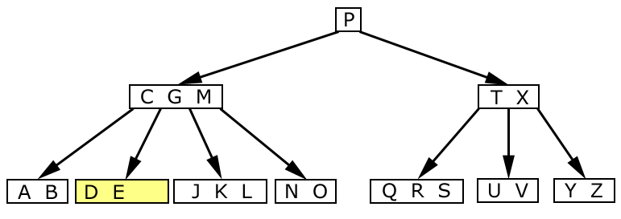
Simple Deletion
Case 1: We delete “F”
Result: We remove “F” from the leaf node. No further action needed.
F
Source: Introduction to Algorithms, Thomas H. Cormen

Slide 41
Deletion Cases (Continued)
Case 2: If the child key k is in node x and x is an internal node, do the following:
x
not a leaf
… k …
y
z

Slide 42
Deletion Cases (Continued)
Subcase a: If the child y that precedes k has at least t keys then find predecessor k´ of k in subtree rooted at y, recursively delete k´ and replace k by k´ in x.
x
x
not a leaf
… k …
… k´…
y
y
≥ t keys
≥ t keys
pred
of k
k´

Slide 43
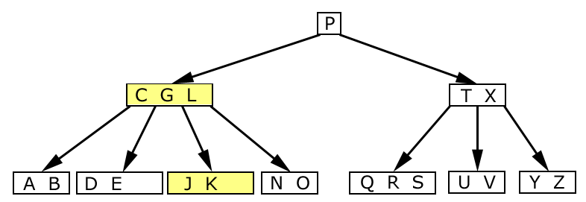
Deleting and shifting
Case 2a: We deleted “M”
Result: We remove “M” from the parent node. Since there are four nodes and two letters, we move “L” to replace “M”. Now, the “N O” node has a parent again.
M
L
Source: Introduction to Algorithms, Thomas H. Cormen

Slide 44
Deletion Cases (Continued)
Subcase B: Symmetrically, if the child z that follows k in node x has at least t keys then find successor k´ of k in subtree rooted at z, recursively delete k´and replace k by k´ in x.
x
x
not a leaf
… k …
… k´…
z
z
≥ t keys
≥ t keys
succ
of k
k´
Comp 750, Fall 2009
B-Trees - <number>

Slide 45
Deletion Cases (Continued)
Subcase C: y and z both have t–1 keys -- merge k and z into y, free z, recursively delete k from y.
x
x
not a leaf
… k …
not a leaf
… …
y
z
y
y’s keys, k, z’s keys
t–1 keys
t–1 keys
2t–1 keys
Comp 750, Fall 2009

Slide 46
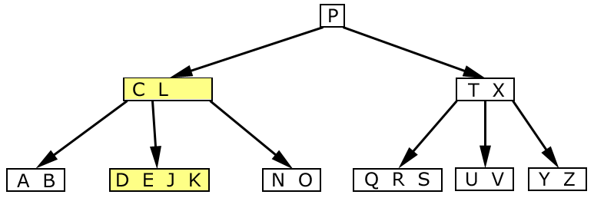
Combining and Deleting
Case 2c: Now, we delete “G”
Result: First, we combine nodes “DE” and “JK”. Then, we push down “G” into the “DEJK” node and delete it as a leaf.
Source: Introduction to Algorithms, Thomas H. Cormen

Slide 47
Combining and Deleting
Case 2c: Now, we delete “G”
Result: First, we combine nodes “DE” and “JK”. Then, we push down “G” into the “DEJK” node and delete it as a leaf.
C L
D E J K
G
Source: Introduction to Algorithms, Thomas H. Cormen

Slide 48
Deletion Cases (Continued)
Case 3: k not in internal node. Let c_{i}[x] be the root of the
subtree that must contain k, if k is in the tree.
If c_{i}[x] has at least t keys, then recursively descend;
otherwise, execute 3.A and 3.B as necessary.
Comp 750, Fall 2009
B-Trees - <number>

Slide 49
Deletion Cases (Continued)
Subcase A: c_{i}[x] has t–1 keys, some sibling has at least t keys.
recursively
descend
x
x
not a leaf
k1
k2
… …
… …
c_{i}[x]
k2
c_{i}[x]
k1
…
…
t–1 keys
t keys
k
k
Comp 750, Fall 2009
B-Trees - <number>

Slide 50
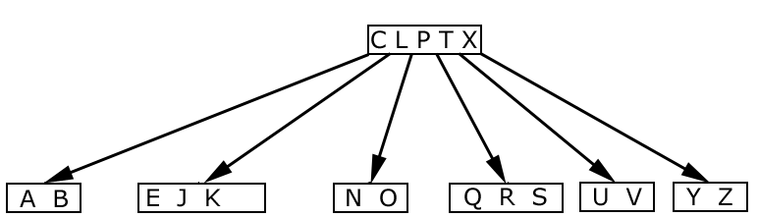
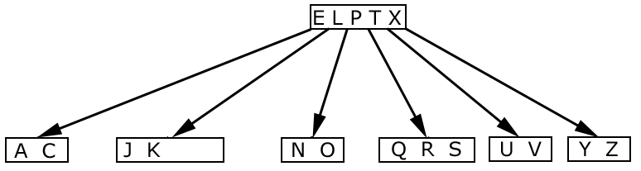
Deleting “B”
Before:
After: Deleted “B”, Demoted “C”, Promoted “E”

Slide 51
Deletion Cases (Continued)
Subcase B: c_{i}[x] and sibling both have t–1 keys.
recursively
descend
x
x
not a leaf
k1
… …
… …
c_{i}[x]
c_{i}[x]
k1
c_{i+1}[x]
c_{i}[x]’s keys, , c_{i+1}[x]’s keys
t–1 keys
t–1 keys
2t–1 keys
k
k
Comp 750, Fall 2009
B-Trees - <number>

Slide 52
Combining and Deleting
Case 3b: Now, we delete “D”
Result: First, we combine nodes “DE” and “JK”. Then, we push down “G” into the “DEJK” node and delete “D” as a leaf.
C L
E G J K
D
Source: Introduction to Algorithms, Thomas H. Cormen

Slide 53
Type #1: Simple leaf deletion
Assuming a 5-way
B-Tree, as before...
12
29
52
2
7
9
15
22
31
43
56
69
72
Delete 2: Since there are enough
keys in the node, just delete it
Note when printed: this slide is animated
CSCI 2720

Slide 54
Type #2: Simple non-leaf deletion
12
29
52
Delete 52
56
7
9
15
22
31
43
56
69
72
Borrow the predecessor
or (in this case) successor
Note when printed: this slide is animated
CSCI 2720

Slide 55
Type #4: Too few keys in node and its siblings
12
29
56
Join back together
7
9
15
22
31
43
69
72
Too few keys!
Delete 72
Note when printed: this slide is animated
CSCI 2720

Slide 56
Type #4: Too few keys in node and its siblings
12
29
7
9
15
22
31
43
56
69
Note when printed: this slide is animated
CSCI 2720

Slide 57
Type #3: Enough siblings
12
29
Demote root key and
promote leaf key
7
9
15
22
31
43
56
69
Delete 22
Note when printed: this slide is animated
CSCI 2720

Slide 58
Type #3: Enough siblings
12
31
7
9
15
29
43
56
69
Note when printed: this slide is animated
CSCI 2720

